Slide 1
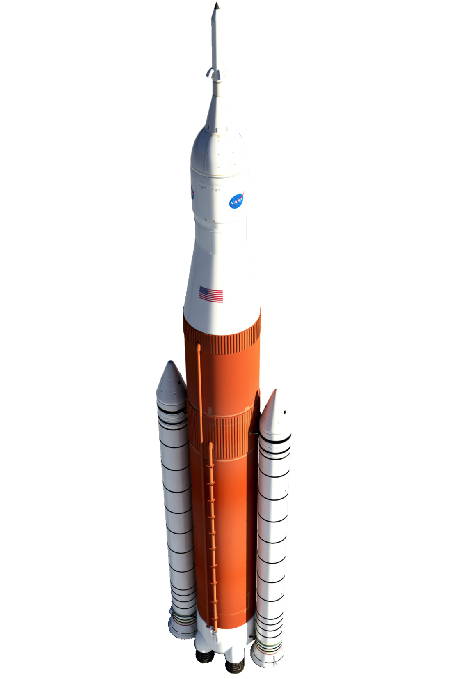
Review of Aeroacoustic Prediction Techniques for Launch Vehicles
Logan Halstrom
12/1/16

Slide 2
Motivation
Launch vehicles experience severe acoustic environments
Launch: engine plumes reflected by pad
Ascent: Transonic flight, unsteady shocks, engine plume noise
Abort: Direct abort motor plume impingement/flow interaction
Potential hazards due to structural vibration
Failure of electrical or mechanical component
Fatigue failure of internal or exterior structural component
Fatigue of payload
Goal: design to minimize acoustics
Need methods of modeling aeroacoustics

Slide 3
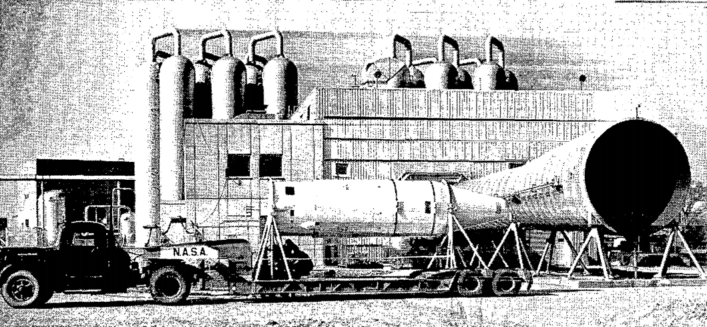
Free-Field Acoustic Testing
Subject test article to unconstrained acoustic source
Need acoustic source similar to flight
Blowdown wind tunnel exhaust
Rocket engine static test

Slide 4
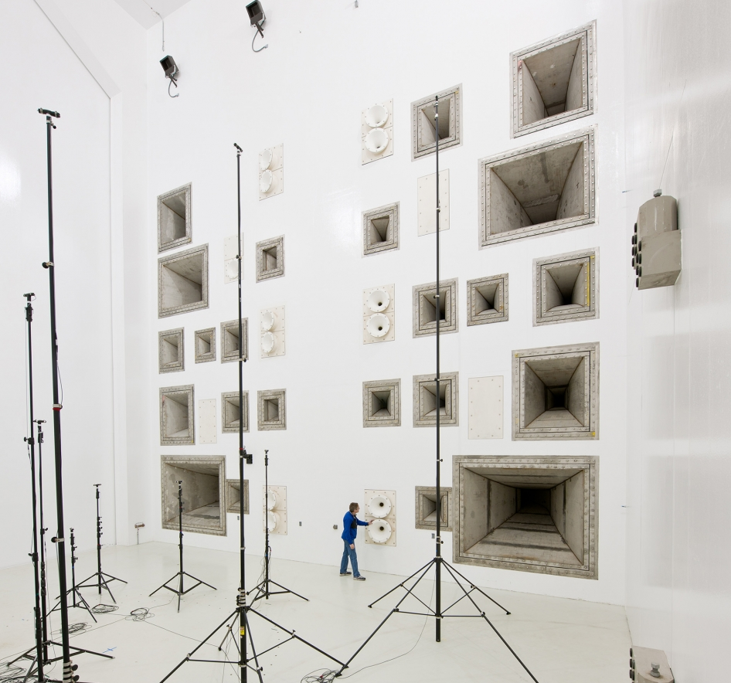
Reverberant Acoustic Testing
Chamber surrounded by noise-producing horns

Slide 5
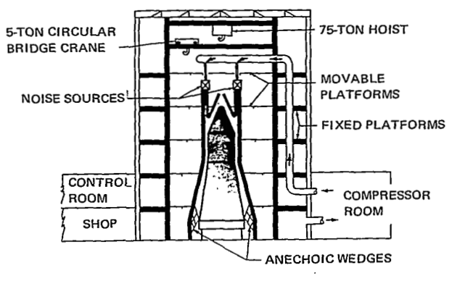
Progressive Wave Test
Chamber connected to outside with many ducts
Acoustic source outside
Control source individually in each duct

Slide 6
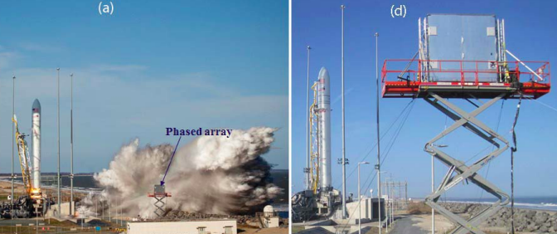
Flight Testing
Full-scale flight test with pressure transducers on vehicle
Microphone Phased-Array
Determine source strength/location accurately from distance

Slide 7
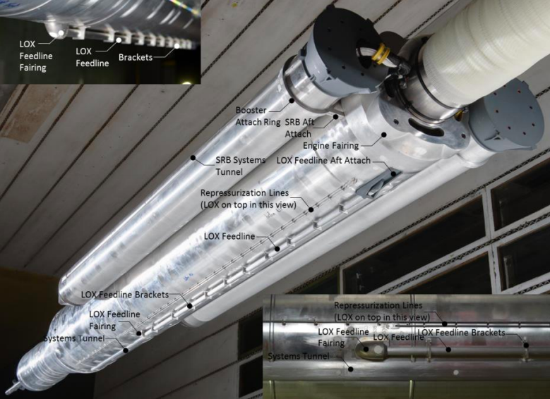
Wind Tunnel - Ascent
Subscale models in scaled flow
Modern manufacturing techniques produce high-fidelity models

Slide 8
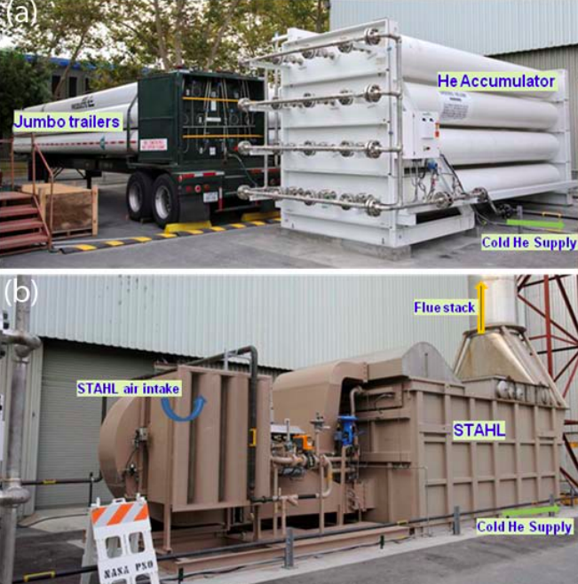
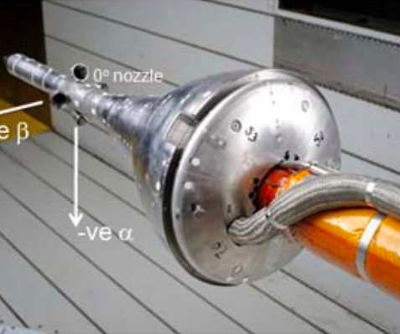
Wind Tunnel - Abort
Use heated Helium to simulate rocket motor plumes

Slide 9
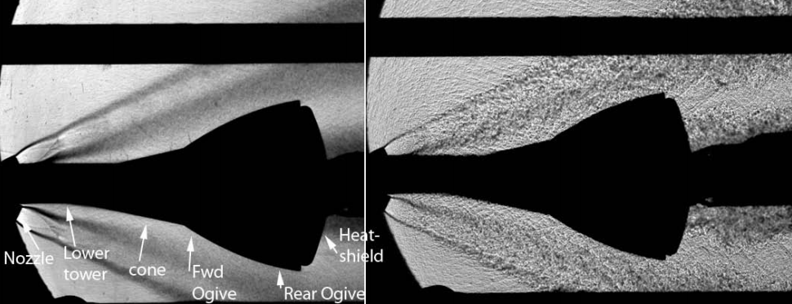
Wind Tunnel - Abort
Complex aeroacoustic effects

Slide 10
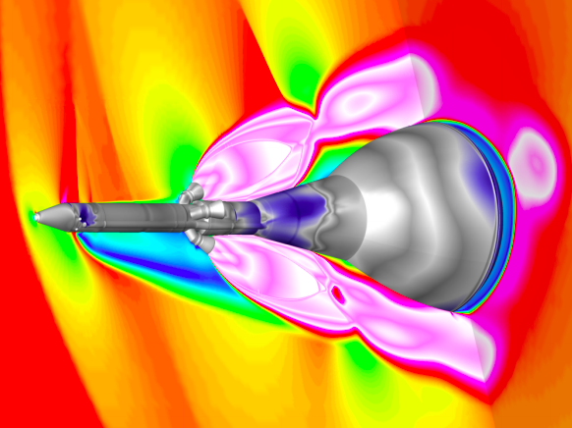
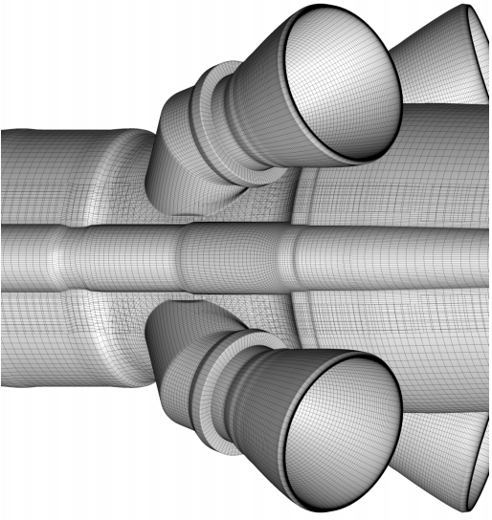
Computational Fluid Dynamics
Can resolve unsteady flow for high-fidelity geometry
Fraction of cost of wind tunnel
Not sophisticated enough for aeroacoustics

Slide 11
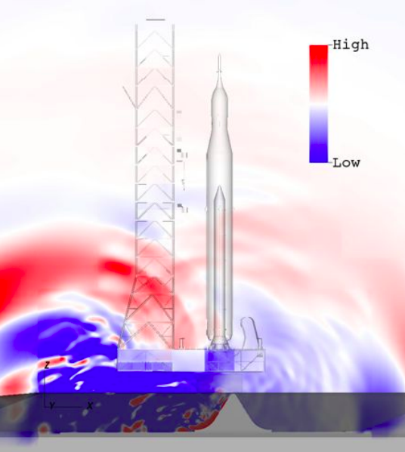
Computational Aero-Acoustics
Couple CFD/CAA solvers to produce acoustic results
LAVA solver (Development still needed)

Slide 12
Conclusions
All discussed methods are uniquely useful
Flight test: can’t beat the real thing
Wind tunnel: much cheaper than flight and still accurate but…
CFD/CAA: Even cheaper! (but less accurate, needs validation data ⬆)
Acoustic testing: structures must be able to survive vibration
The future
Computational methods will improve, become more ubiquitous
Experimental methods will always be required to check computational

